Slide 1
Financial Performance Analysis

Slide 2
ABOUT project
This Power BI project was undertaken to conduct a comprehensive analysis of global financial performance, transforming raw financial data into actionable strategic insights. The core objective was to dissect and understand the interplay of key financial metrics—including Sales, Profit, Cost of Goods Sold (COGS), and Discounts—across critical business dimensions.
The final deliverable is an interactive Power BI dashboard that serves as a centralized tool for stakeholders to visually explore the data, identify key drivers of success, and pinpoint areas for improvement, thereby enabling data-driven decision-making.

Slide 3
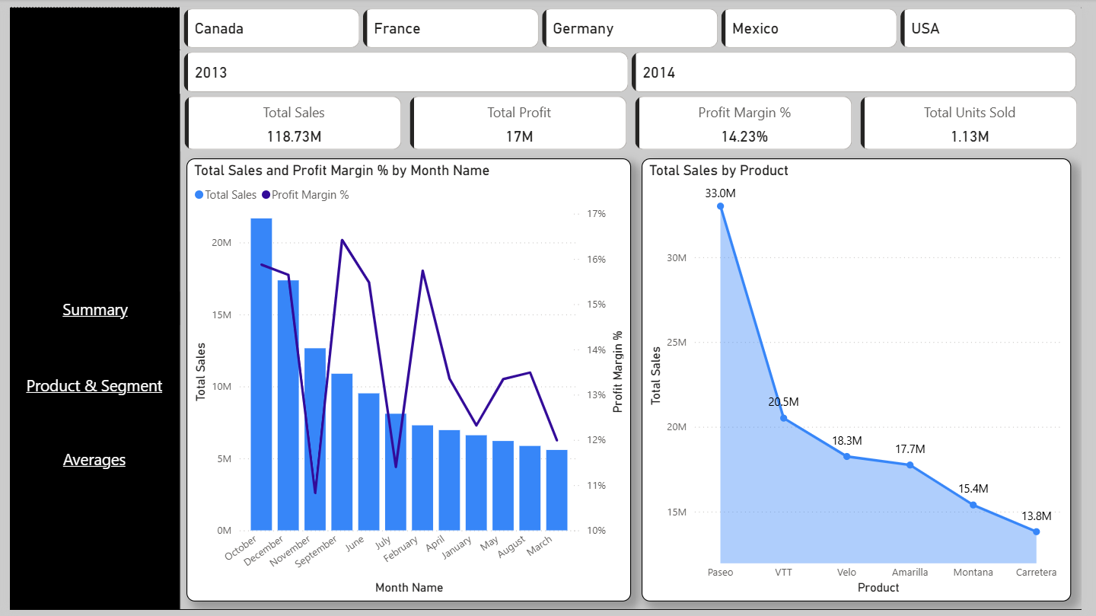
Summary dashboard

Slide 4
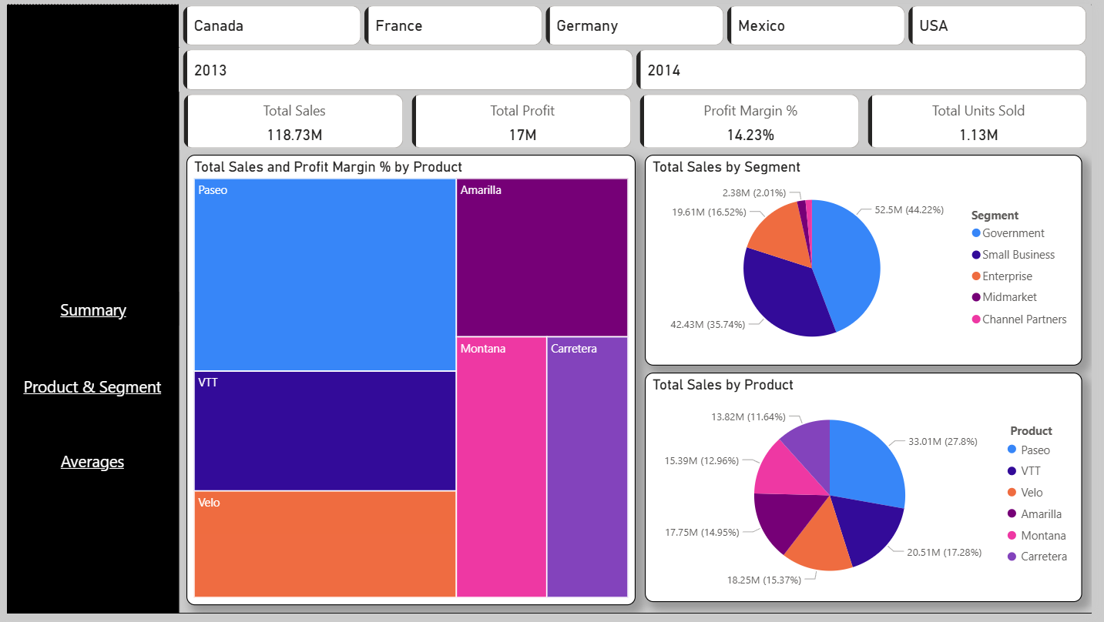
Product and segment

Slide 5
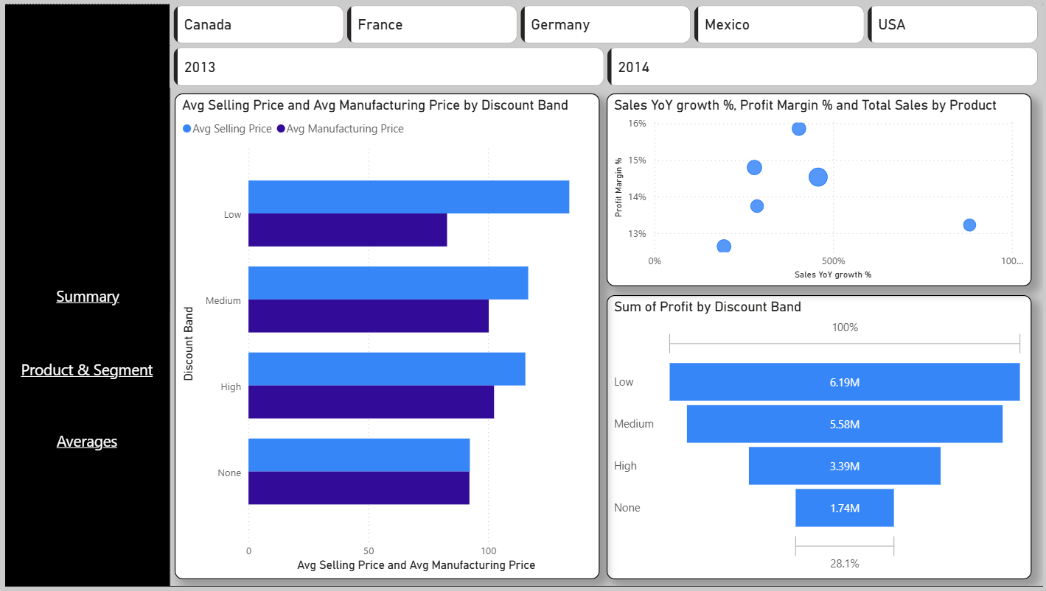
Averages(discount analysis)

Slide 6
Executive Summary:
Features: KPI cards (Sales, Profit, Margin), Sales Trend vs. Forecast, YoY Growth Analysis, Geographic Performance Map.
We use high-impact KPI cards for instant performance recognition, trend lines to visualize progress over time, and geographic maps for intuitive regional analysis.
This page instantly reveals if the company is hitting its financial targets, identifies growth patterns and seasonal trends, and pinpoints high-performing regions that are driving results, enabling swift strategic direction.
Product & Segment Analysis:
Features: Product Profitability Treemap, Segment Sales Breakdown, Detailed Performance Matrix.
Treemaps and pie charts efficiently show part-to-whole relationships and market share, while the detailed matrix provides the granular data needed for root-cause analysis.
This page identifies star products and underperformers in our portfolio, reveals which customer segments are most valuable, and uncovers specific opportunities, such as a high-selling but low-margin product in a key segment.
AVERAGES(DISCOUNT ANALYSIS):
Features: Discount vs. Profitability Scatter Plot, Discount Adoption by Segment, Impact of Discounts on Unit Economics.
The scatter plot is critical for revealing the correlation between discount levels and profitability, while the composition charts show how discounts are allocated.
This page directly identifies whether discount strategies are generating profitable growth or eroding margins, highlights which customer segments receive the deepest discounts, and informs a more data-driven and profitable commercial policy.

Slide 7
Project OVERVIEW
Overview:
This Power BI dashboard delivers a comprehensive analysis of India's electric vehicle (EV) market, serving as an interactive platform for strategic planning. The dashboard enables stakeholders to identify key opportunities, optimize resource allocation, and track the evolution of the EV ecosystem from 2014 to 2024.
Key Insights from the Data:
Market Leadership: A clear market was observed where states dominated EV adoption. Uttar Pradesh, Maharashtra, and Karnataka emerged as leaders, accounting for the majority of national EV sales.
Category Performance Analysis: The 2-wheeler and 3-wheeler categories dominated market share, significantly outperforming other vehicle segments and establishing themselves as the primary growth engines of the EV revolution.
Growth Pattern Identification: Strong year-over-year growth was evident across most vehicle categories, with particular momentum in the 2-wheeler and 3-wheeler segments.
Strategic Categorization: Vehicle classes were successfully classified by market share and growth potential, clearly distinguishing high-volume categories (M-Cycle/Scooter, E-Rickshaw) from emerging niche segments (Commercial Vehicles, Agricultural Trailers) for targeted strategy development.

